Slide 1
Motivation

Slide 2
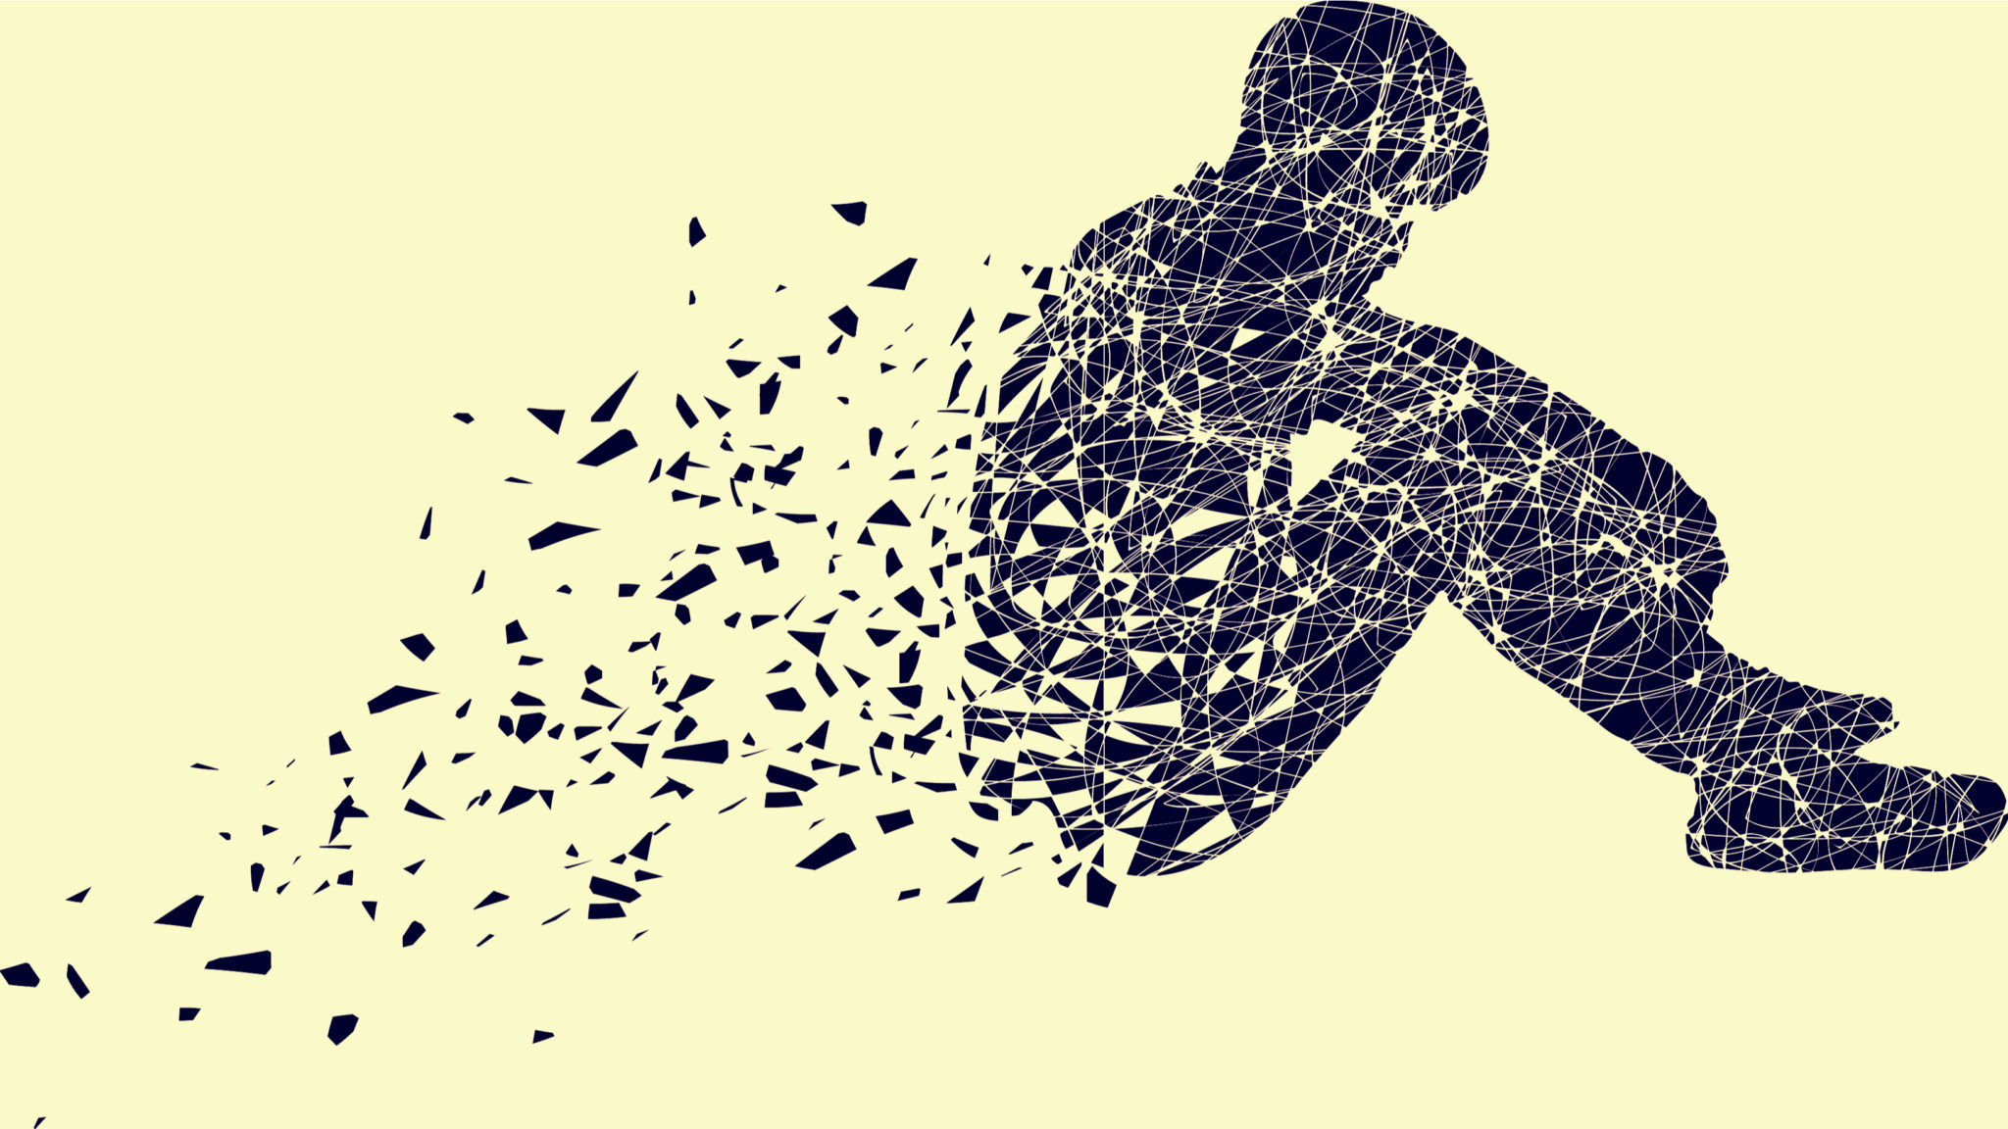
Current Social Media
Promotes online human interaction
Used to connect people from around the world
Simplifying online communication
Not meant to replace in person interaction
This form of interaction can cause negative impacts such as
Fear of missing out
Isolation
Depression
Anxiety
Notes:
Our motivation for this project comes directly from some of the issues we see in current social media.
Social media puts heavy emphasis on online human interaction which fits the original purpose, connecting those from around the world and simplifying online communication. With that being said, it wasn’t made to entirely replace in person interactions which seems to be what it's doing.
Additionally, we see negative impacts from the rise of social media. According to helpguide.org we see people have the fear of missing out, feeling isolated, and even gaining depression and anxiety.
First, fear of missing out is the feeling that those around you are having experiences that you don’t have. This is extremely apparent in social media when many tend to post pictures or talk about events that they had attended or locations they went to.
Next, we believe that though you are pseudo-interacting with others, a majority of the time you spend browsing social media is alone. This is what causes the feeling of isolation.
Lastly, depression and anxiety thrive in those that are alone. Many fill their emptiness by going on social media and don’t receive the physical interaction they actually need.
As it is becoming apparent, there are many negative effects that occur due to social media and it’s promotion of online and not in person interactions. Our project is built to change this.

Slide 3
RSVPme
A new system to create and attend events in the real world
Promotes in-person interactions
Meeting others offline
Allows for public and private events
Public events allows those to meet new people and find new events that they didn’t know they liked before
Private events allows those that are friends with one another to do more things together in-person
Notes:
RSVPme is built to be a new social media system that is used to create and attend real world events. This should promote in-person interactions and meeting new people offline
We hope to accomplish both of these tasks by creating public and private events.
Public events will allow people to meet as they are not forced to be friends to both attend the event. This also allows those to find new events they may not have tried or liked before. Examples of public events could be things such as football games, car meetups, or book clubs.
Private events on the other hand require those going to be friends or friends of friends. ALthough this doesn’t allow much for meeting new people, it still gets those that are friends to meet outside their computers and phones and have meaningful offline experiences. Examples of this could be parties, going out to eat, or going to the park.
We hope that this new approach on social media will promote positive experiences with those around you and help counteract the negative impacts of common social media.

Slide 4
FUNCTIONALITIES
Interactive Map:
A map users can manipulate that shows events in the area.
RSVP System:
Add\remove friends, follow companies, update the map to show events.
Create Event:
Create private and public events, and edit their event’s details
Friend Groups:
Create multiple groups to invite friends to.

Slide 5
Functionalities
Notification System:
Users can opt to receive notifications for events they follow, as well as by proximity.
QR Code Invitations:
Add friends and follow events using QR code.
Calendar:
Automatically sync the app up with popular calendar apps.
Filter for Public Events:
Users will be able to filter out events on the map they are not interested in.
Direct Messaging:
Event organizers can message users following their event, and users can create group messages.

Slide 6
FRONT END DESIGN
The front end we use native react
The app will cover Android and IOS
User centered experience
Login with Facebook or Google account
Interactive with a nature way
Custom user interface layout
Data visualization

Slide 7
BACK END DESIGN
The back end we implement on a cloud server which using CentOS + Nginx + Php + MongoDB
The server can offer millions of user requests 24/7
Consider of the application type we decided to using HTTP request rather than Socket connection.
The server mainly for authentication / process event information / handle notifications / deal with user relations.

Slide 8
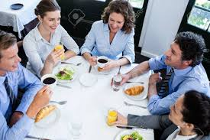
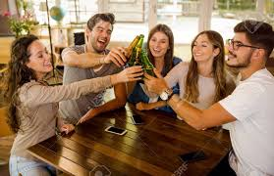
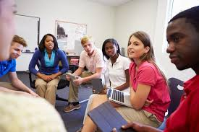
Outcomes
An app for everyone

Slide 9
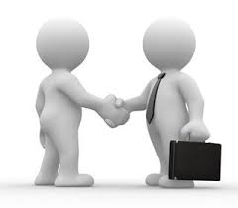
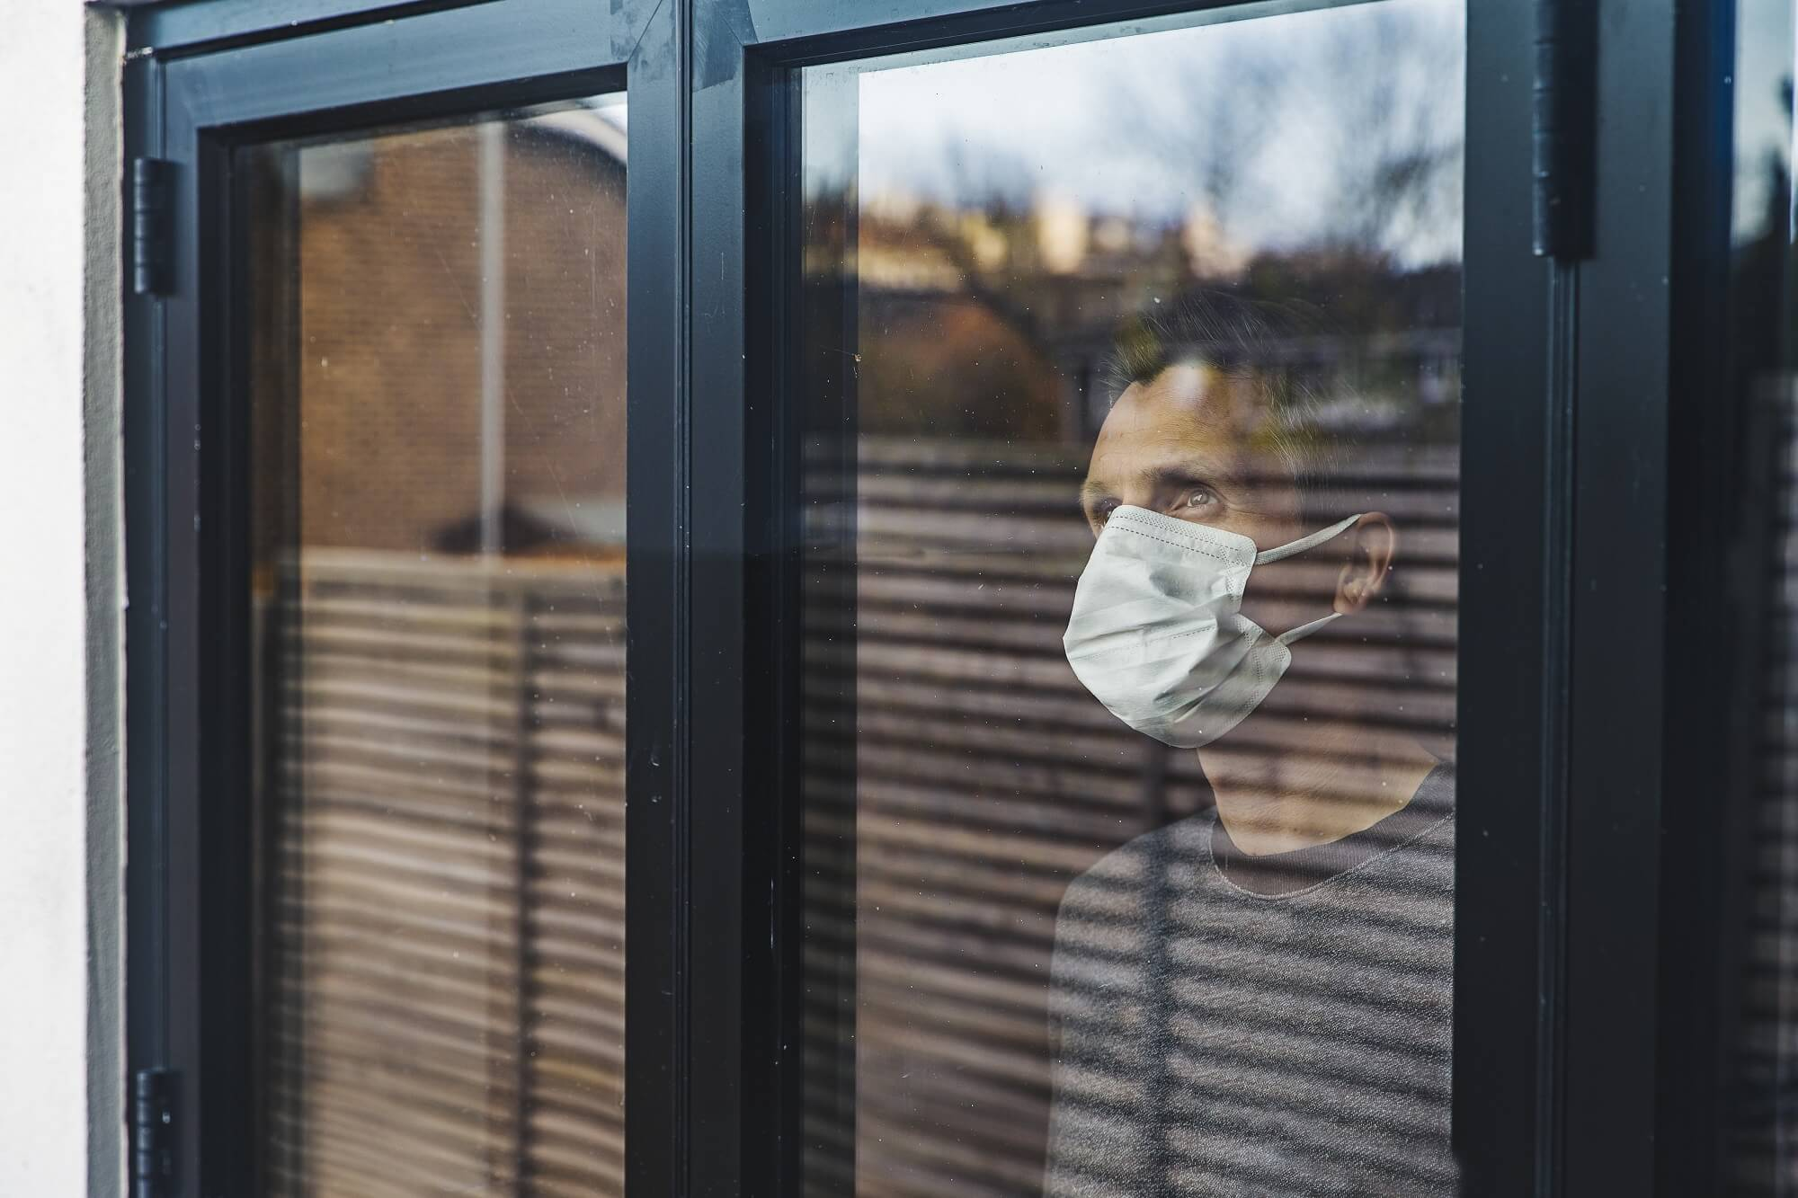
Outcomes - Individual and Connections
Facilitate person to person interactions
Much needed after COVID isolation

Slide 10
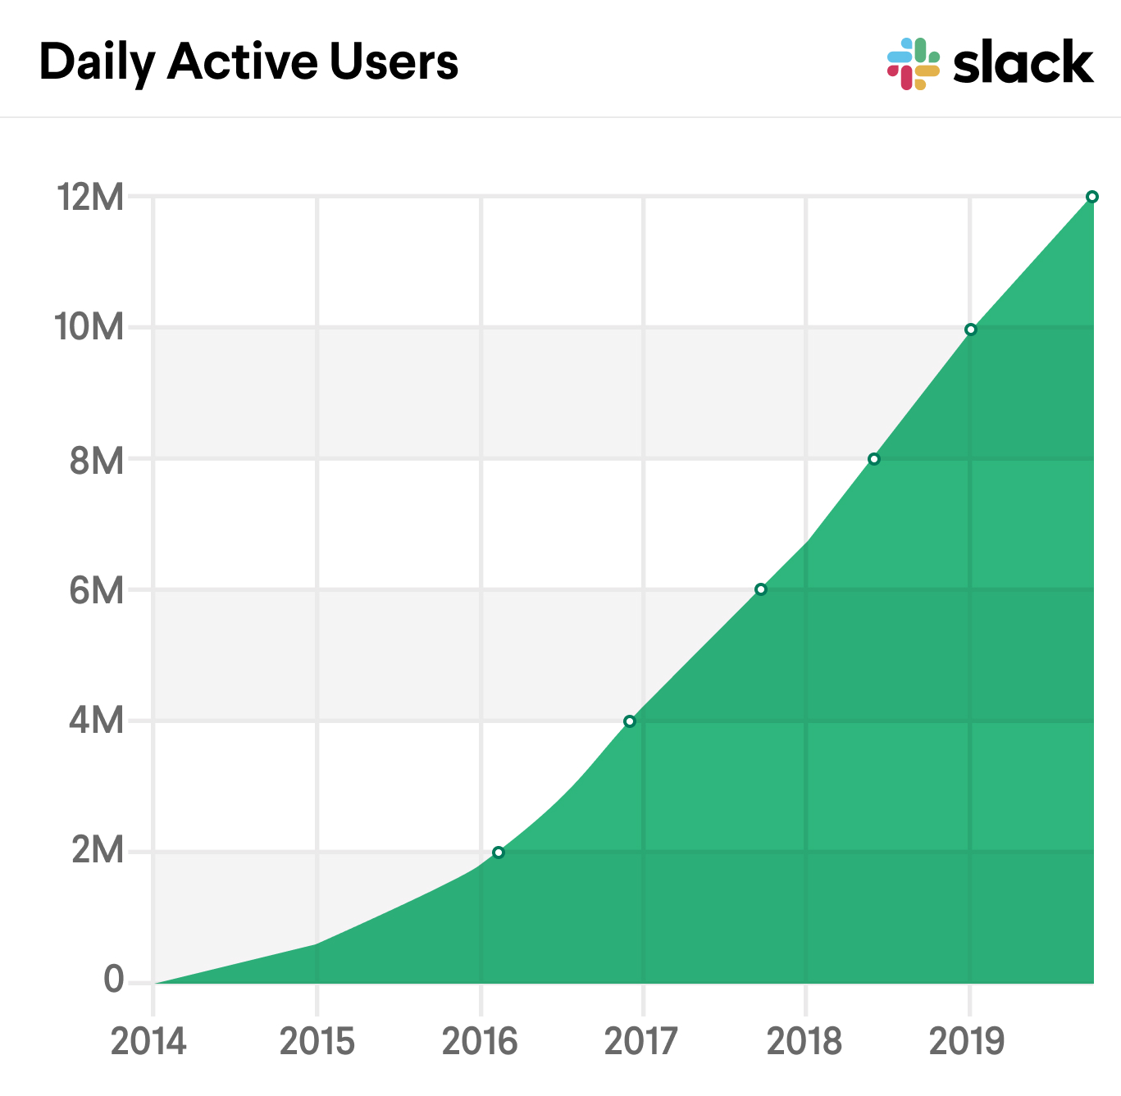
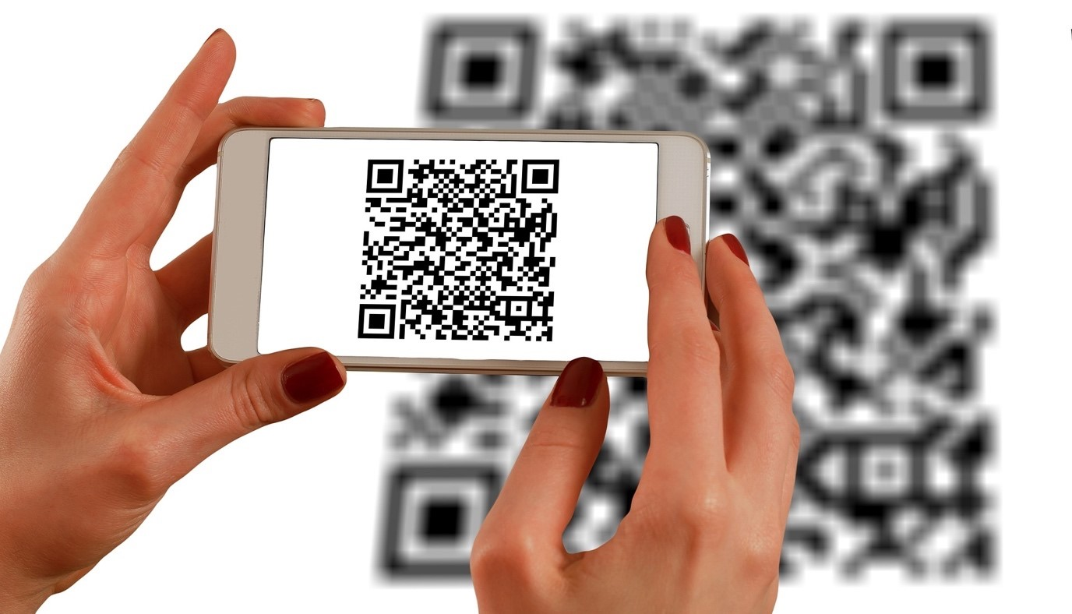
Outcomes - Individual and Connections
Convenient method to add friends
Expect growth due to ease of use
Positive feedback loop

Slide 11
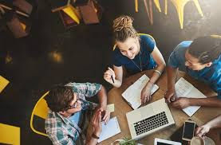
Outcomes - For organizations
TTU - RSVPme promotes better study habits
-
Businesses
- advertising
-

Slide 12
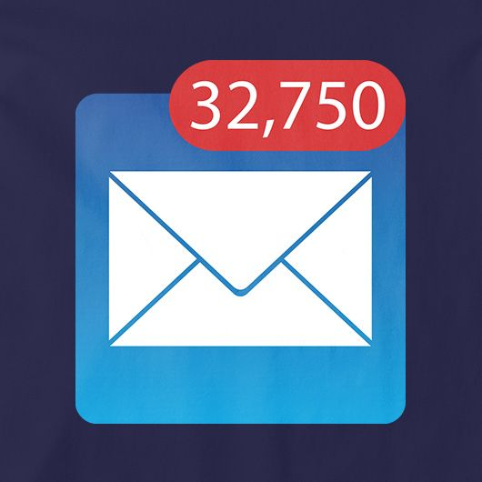
Outcomes (cont’d)
Less spam emails from TTU
Economic and Environmental benefits
Less flyers/posters saves money
Fact about paper waste
4 million tons of paper used annually
324 liters of water is used to make 1 kilogram of paper

Slide 13
Reference:
https://www.helpguide.org/articles/mental-health/social-media-and-mental-health.htm
https://www.theworldcounts.com/stories/paper-waste-facts

